Slide 1



Call Center Trends
View in Power BI
Last data refresh:
3/16/2024 9:34:20 AM UTC
Downloaded at:
3/16/2024 9:40:26 AM UTC

Slide 2
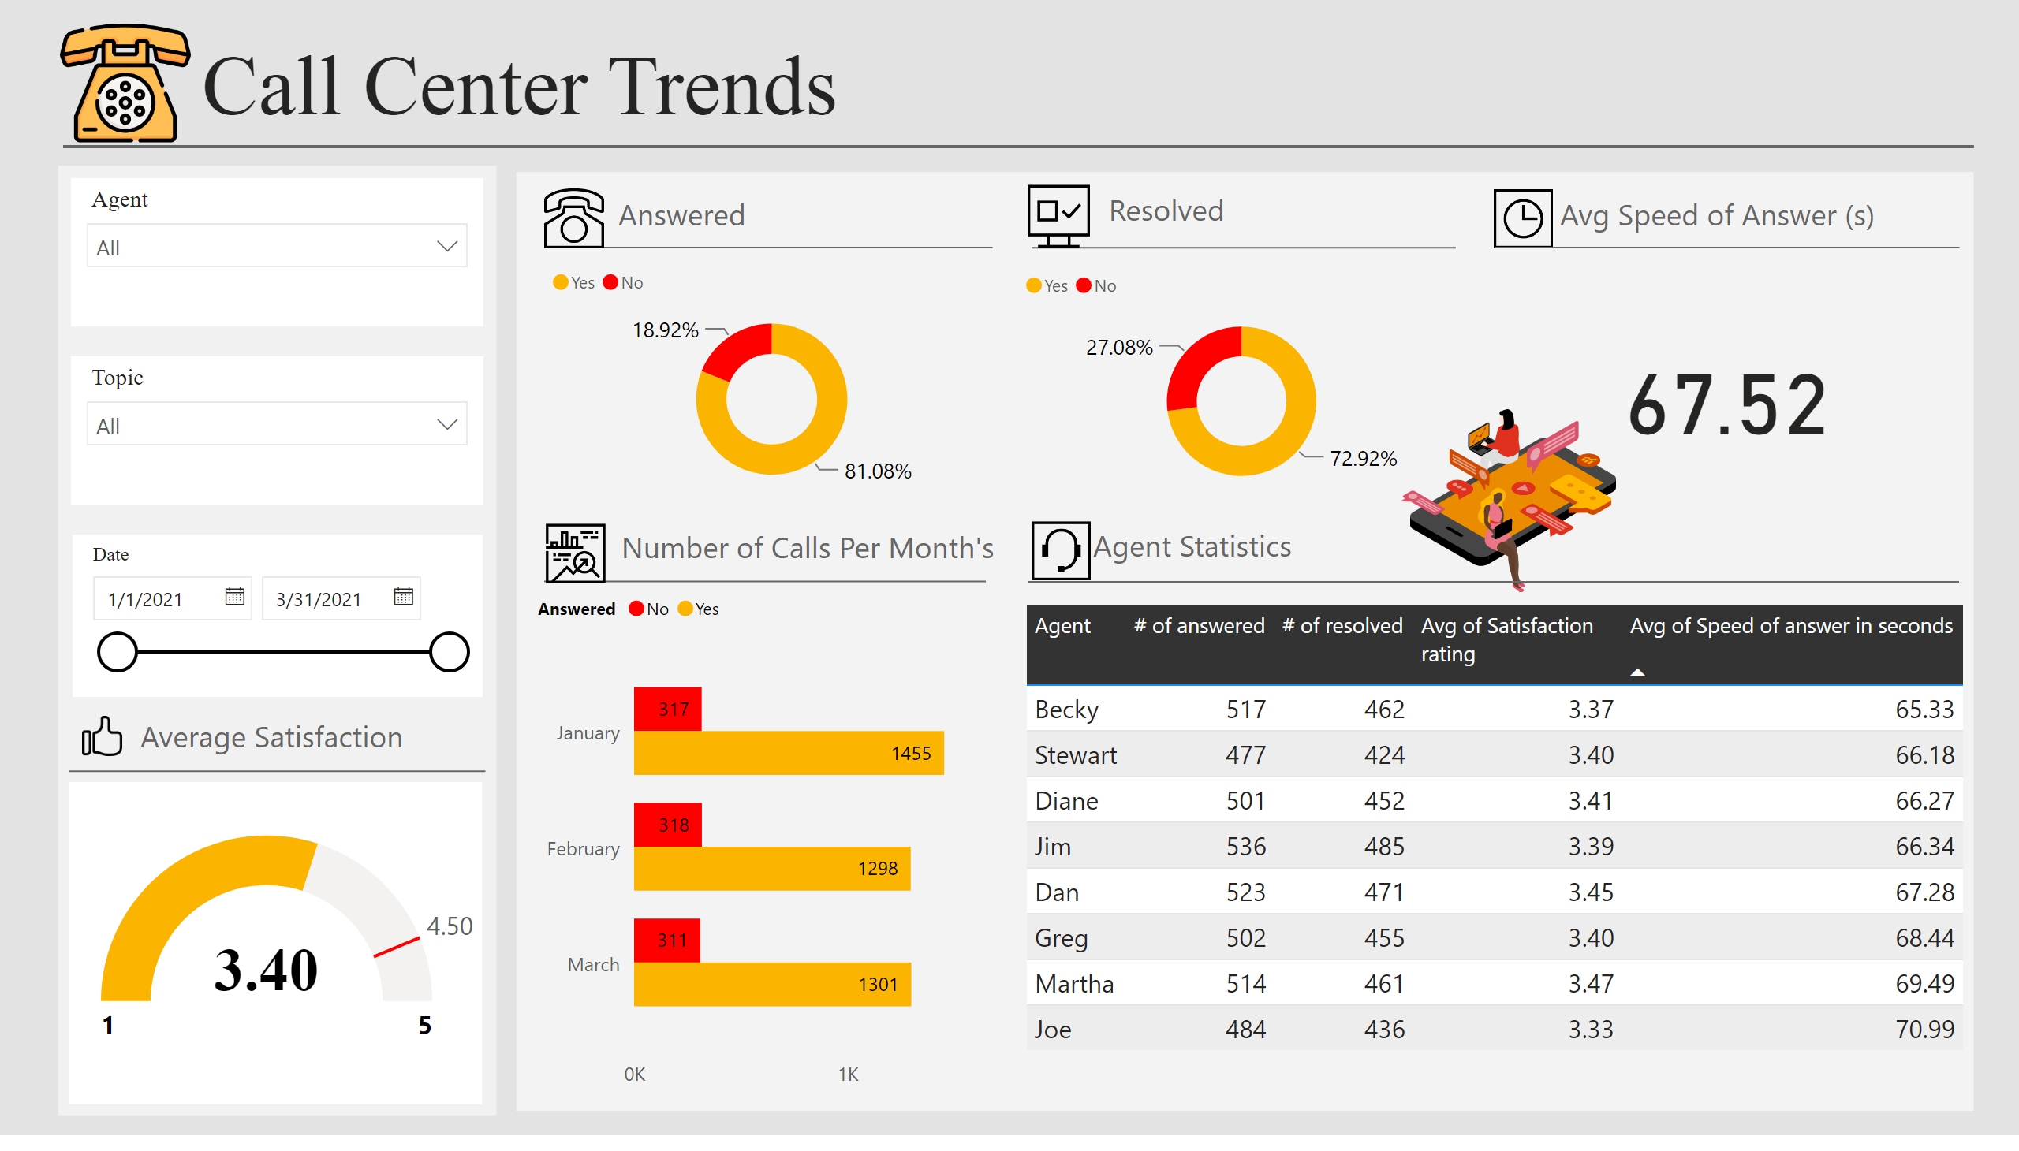
Call Center Trends
Notes:
basicShape
No alt text provided
textbox
No alt text provided
image
No alt text provided
shape
No alt text provided
textbox
No alt text provided
basicShape
No alt text provided
slicer
No alt text provided
slicer
No alt text provided
slicer
No alt text provided
gauge
No alt text provided
basicShape
No alt text provided
basicShape
No alt text provided
basicShape
No alt text provided
basicShape
No alt text provided
textbox
No alt text provided
image
No alt text provided
image
No alt text provided
textbox
No alt text provided
image
No alt text provided
donutChart
No alt text provided
donutChart
No alt text provided
image
No alt text provided
card
No alt text provided
basicShape
No alt text provided
basicShape
No alt text provided
textbox
No alt text provided
textbox
No alt text provided
image
No alt text provided
image
No alt text provided
tableEx
No alt text provided
clusteredBarChart
No alt text provided
textbox
No alt text provided
image
No alt text provided

